Slide 1



Edge-Based Smart Irrigation System For Precision Agriculture
Edge AI
2025
Maharudra (DM), Nikhil N S(DM), Surya Tomar(DM), and Pandarasamy Arjunan
Background and Motivation
Lack of knowledge about crop water requirements and reliance on traditional irrigation methods often lead to water waste, soil salinity, nutrient leaching and ultimately reducing crop quality an and waterlogging during the seedling stage disrupting soil aeration, causing uneven early growth yield. There is a pressing need for a fully autonomous, edge-computed precision irrigation system that dynamically adjusts to crop growth stages, real-time soil conditions and weather variability.
Objectives
ET₀ Prediction: Calculate daily reference evapotranspiration from T₂Mmax, RH and radiation.
ETc Derivation: Multiply ET₀ by growth-stage crop coefficient (Kc) to get actual crop water demand.
Soil Sensing: Capacitive moisture sensor measures volumetric water content, converts to available water depth.
Edge Computation: Raspberry Pi Pico W runs rule-based/ML fusion of ETc and soil data to determine irrigation volume and timing.
Automated Actuation: ESP32 node via MQTT drives pump relay for the computed duration, ensuring precise delivery.
Dataset / Data collection
Historical Climate Data Collection & Labeling Retrieved 34 years of daily records (T₂M₍ₘᵢₙ₎, T₂M₍ₘₐₓ₎, RH₂ₘ, WS₂ₘ, ALLSKY_SFC_SW_DWN) from NASA POWER API.
Computed daily reference evapotranspiration (ET₀) via the FAO 56 Penman–Monteith equation to generate supervised labels.
Data Preprocessing & Feature
Selection Cleaned data by removing outliers; applied. Performed correlation analysis; selected the three most predictive features: T₂M₍ₘₐₓ₎, RH₂ₘ, and ALLSKY_SFC_SW_DWN.
Edge AI Model
Predicts ET0 on the basis of parameters we get from API on Raspberry Pi Pico.
Model compression: 18kb(original model size) to 12kb (compressed model size)
Model characteristics
Size before and after compression.
Performance
Latency
Hardware and Software spec.
Raspberry Pi Pico()
ESP32 Microcontroller
Soil Moisture Sensor (Analog)
Relay Module
Water pump
Prototype & demonstration
TODO
Link/QR to GitHub, video, etc.
Project git link

Slide 2


CP 330: Edge AI Edge-Based Smart Irrigation System For Precision Agriculture
Maharudra, DM, maharudrar@iisc.ac.in
Nikhil N S, DM, nikhilns@iisc.ac.in
Surya Tomar, DM, suryatomar@iisc.ac.in
Pandarasamy Arjunan, RBCCPS, samy@iisc.ac.in
Indian Institute of Science, Bangalore
Image source: https://leverx.com

Slide 3

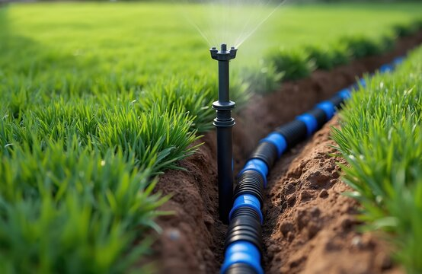

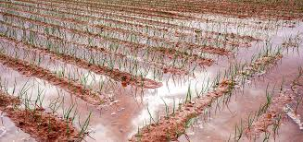
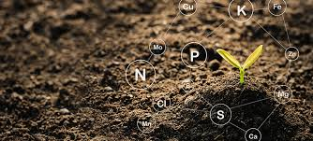
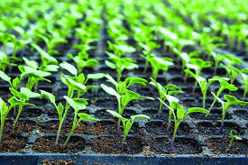
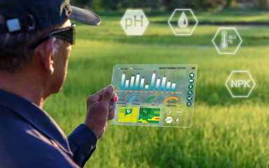
INTRODUCTION
Lack of knowledge about crop water requirement leads
Traditional irrigation methods often waste water 🌊
Over-irrigation causes soil salinity and reduces crop quality
Leaching of nutrients to the deep soil takes place
Affecting to Seedling-stage crops
Waterlogging during seedling stages disrupts soil aeration, causing uneven plant growth at early stages leads to drop in crop yield
Need for a fully autonomous, edge-computed precision irrigation system
edge-computed precision irrigation system that dynamically responds to crop growth stages, real-time soil conditions, and weather variability.
CP 330: EDGE AI

Slide 4

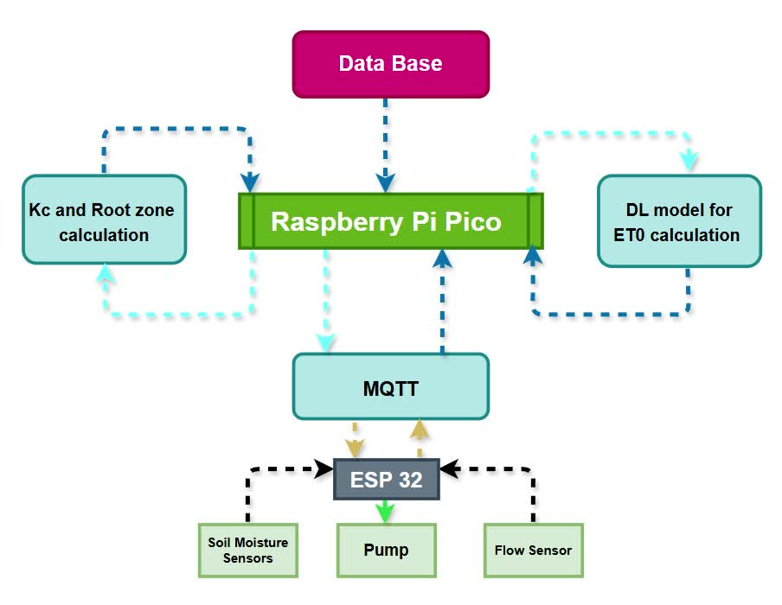
OBJECTIVES
1.
Predict Crop Water Demand : Compute daily reference evapotranspiration (ET₀) from forecasted meteorological data ( T₂Mmax, RH, Radiation).
2
Derive Crop ETc: Incorporate growth-stage-specific crop coefficient (Kc) to obtain actual crop water requirement (ETc).
3
Real-Time Soil Sensing: Use capacitive soil moisture sensor to measure volumetric water content, convert to available water depth.
Edge Computation: Implement rule-based and ML model on Raspberry Pi Pico W to fuse ETc and soil data, predict irrigation volume and time.
4
5
Automated Actuation: Wirelessly command ESP32 node to run pump via relay for calculated duration trough MQTT, ensuring precise delivery.
CP 330: EDGE AI

Slide 5


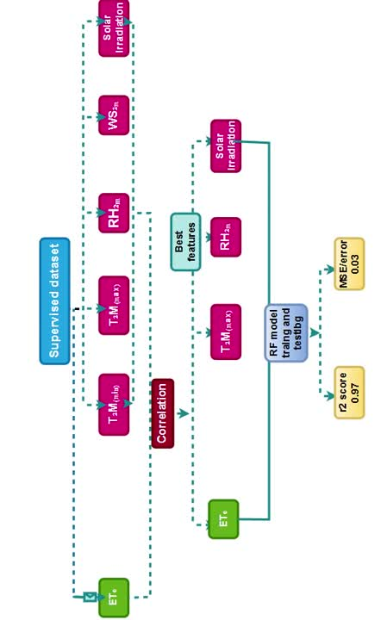
SYSTEM ARCHITECTURE
1.
Historical Climate Data Collection & Labeling
Retrieved 34 years of daily records (T₂M₍ₘᵢₙ₎, T₂M₍ₘₐₓ₎, RH₂ₘ, WS₂ₘ, ALLSKY_SFC_SW_DWN) from NASA POWER.
Computed daily reference evapotranspiration (ET₀) via the FAO 56 Penman–Monteith equation to generate supervised labels.
2.
Data Preprocessing & Feature Selection
Cleaned data by removing outliers; applied z-score normalization for zero-mean, unit-variance scaling.
Performed correlation analysis; selected the three most predictive features: T₂M₍ₘₐₓ₎, RH₂ₘ, and ALLSKY_SFC_SW_DWN.
3.
Randon forest Modeling
Trained a feedforward neural network. on the processed dataset to predict ET₀.
Achieved ~97% test-set accuracy; exported the optimized model (e.g., TensorFlow Lite) for on-device inference.
06
CP 330: EDGE AI

Slide 6
SYSTEM ARCHITECTURE
1.
Real-Time Weather & ET₀ Inference
Fetched current T₂M₍ₘₐₓ₎, RH₂ₘ, and solar radiation via the OpenWeather API.
Ran the trained model on the Raspberry Pi Pico W to predict today’s ET₀ in under 100 ms.
4.
Irrigation Requirement Computation
Compute crop evapotranspiration: ETc = Kc × ET₀
Determine water deficit: Dᵣₑₛ = ETc – Dₐᵥₐᵢₗ
Compute required volume: V = A × Dᵣₑₛ
Convert to irrigation time: t = V / Q (where Q is pump flow rate).
2.
Crop & Field Parameter Configuration
User inputs: crop species, sowing date, inter-row and plant spacing, total plant count.
Rule-based lookup assigns crop coefficient (Kc) and rooting depth based on growth stage.
Calculates irrigation area: A = N × S².
5.
Wireless Control & Actuation Loop
ESP32 → Transmits Dₐᵥₐᵢₗ to Pico W over local Wi-Fi.
Pico W → Executes inference and calculation; returns t (s) to ESP32.
ESP32 → Drives relay for t seconds, activating the pump for precision irrigation.
3.
Real-Time Soil Moisture Monitoring
ESP32 reads volumetric water content θ (%) from a calibrated capacitive sensor.
Computes available soil water depth: Dₐᵥₐᵢₗ = θ × Zₚ.
CP 330: EDGE AI

Slide 7

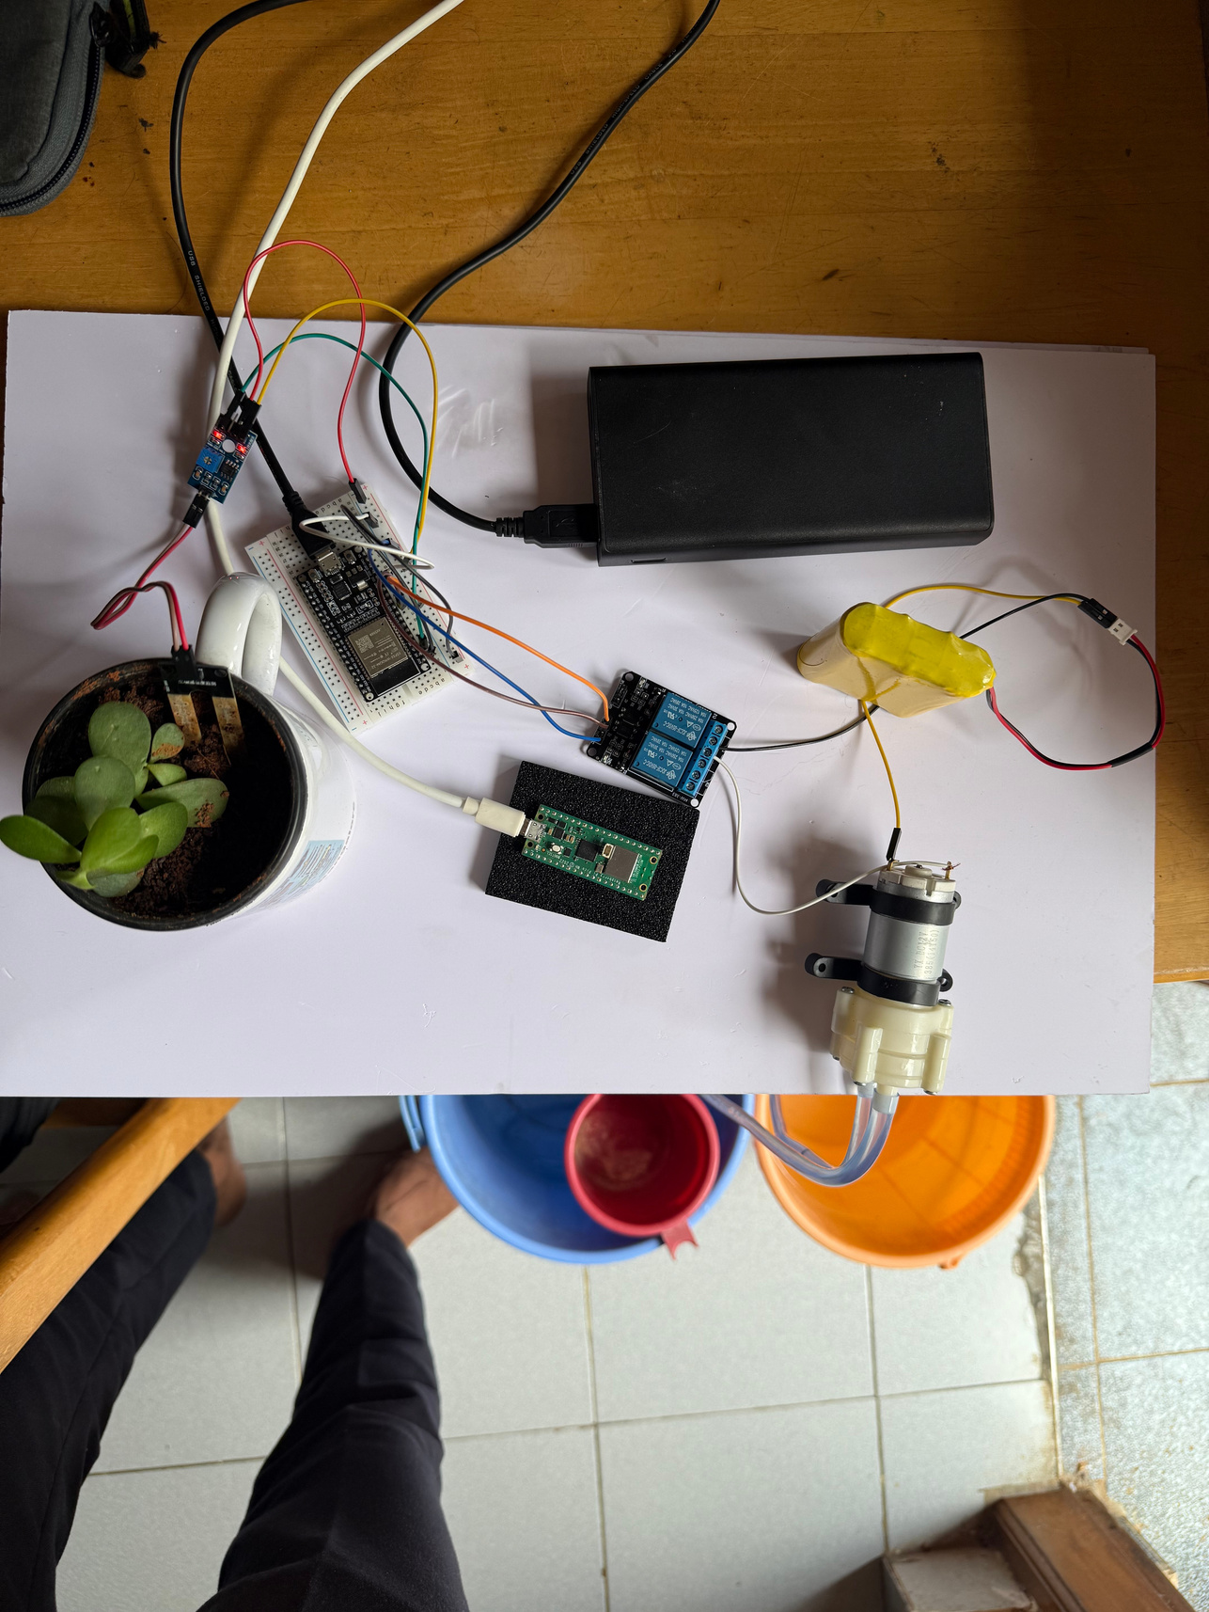
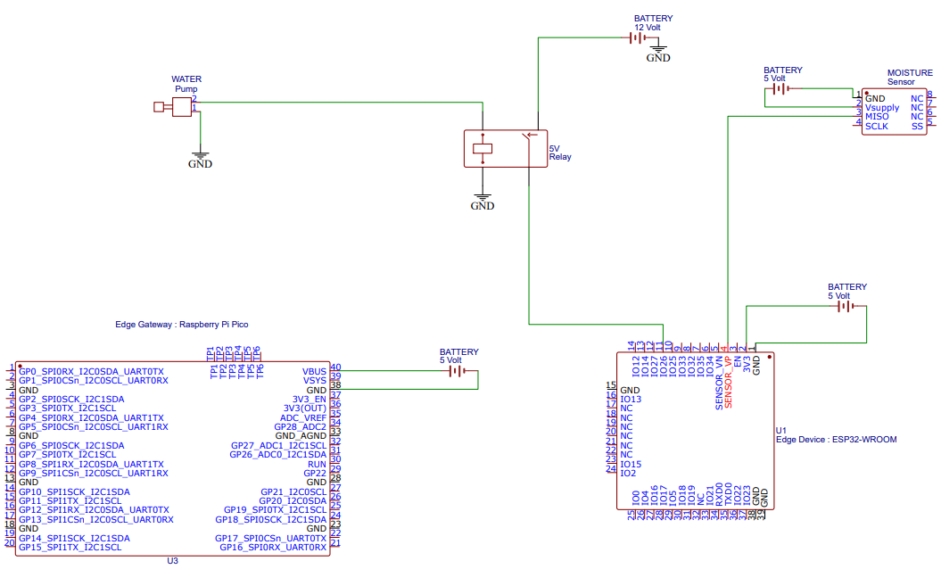
SYSTEM INTEGRATION AND CONTROL
COMPONENTS
ESP32 MICROCONTROLLER
THE BRAIN OF THE SYSTEM, RESPONSIBLE FOR:
CONNECTING TO WI-FI.
READING DATA FROM THE SOIL MOISTURE SENSOR.
ESTABLISHING A SECURE MQTT CONNECTION WITH HIVE CLOUD.
PUBLISHING SENSOR DATA.
CONTROLLING THE RELAY TO SWITCH THE WATER PUMP.
SOIL MOISTURE SENSOR (ANALOG)
MEASURES THE WATER CONTENT IN THE SOIL BY OUTPUTTING AN ANALOG VOLTAGE.
RELAY MODULE :
An electrically controlled switch used to turn the water pump ON or OFF.
HIVEMQ CLOUD:
A cloud-based MQTT broker for message exchange between
the ESP32 and any monitoring applications.
Raspberry Pi Pico
CP 330: EDGE AI

Slide 8
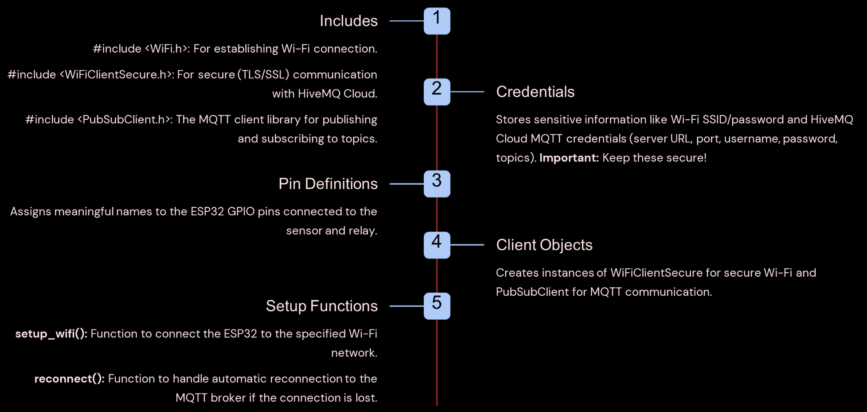
SYSTEM INTEGRATION AND CONTROL
CODE BREAKDOWN - CORE LOGIC
CP 330: EDGE AI

Slide 9
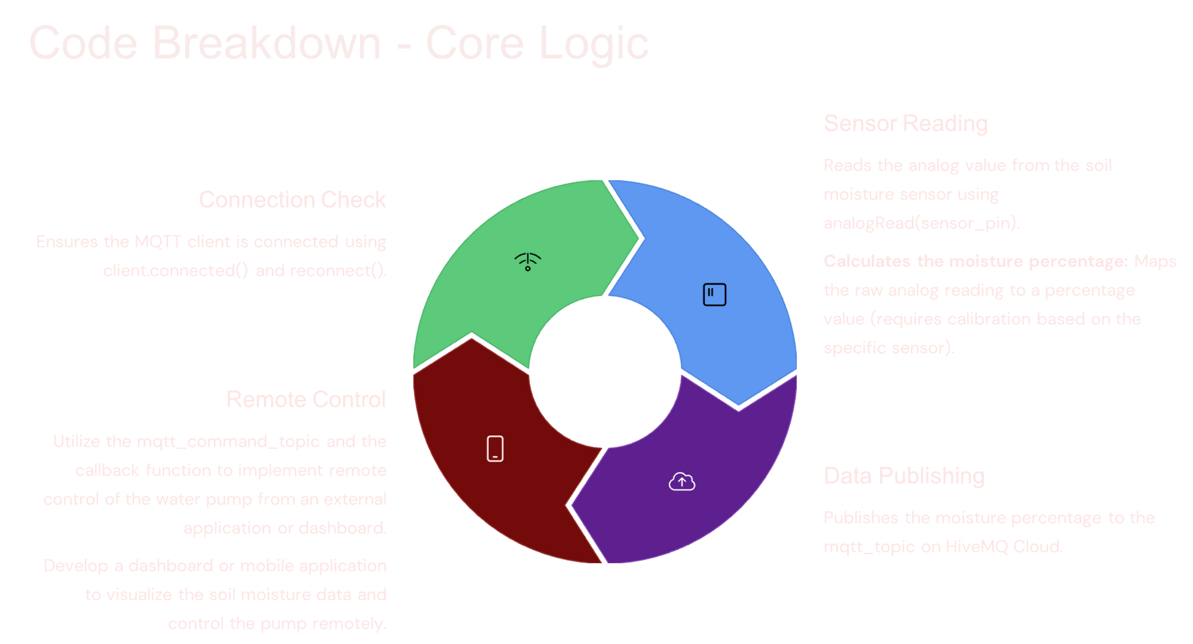
SYSTEM INTEGRATION AND CONTROL
CODE BREAKDOWN - CORE LOGIC
CP 330: EDGE AI

Slide 10
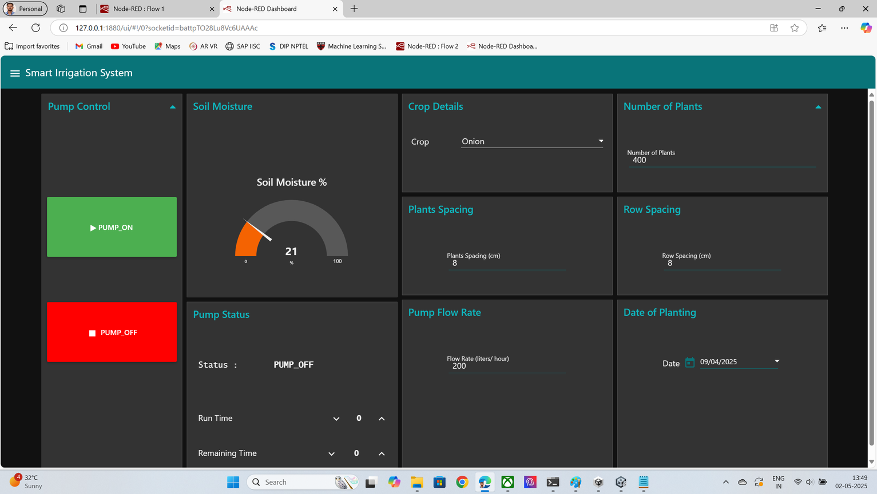
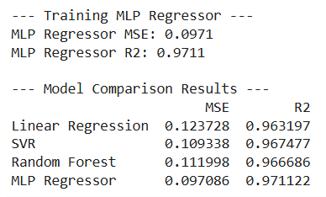
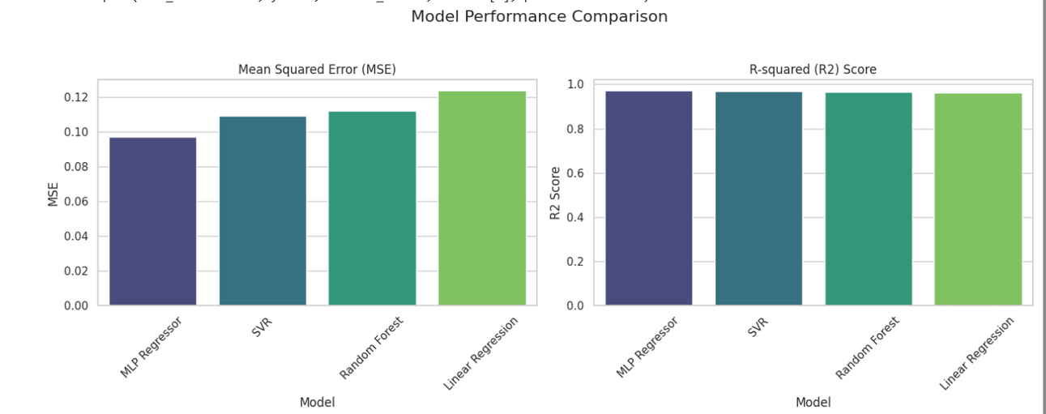
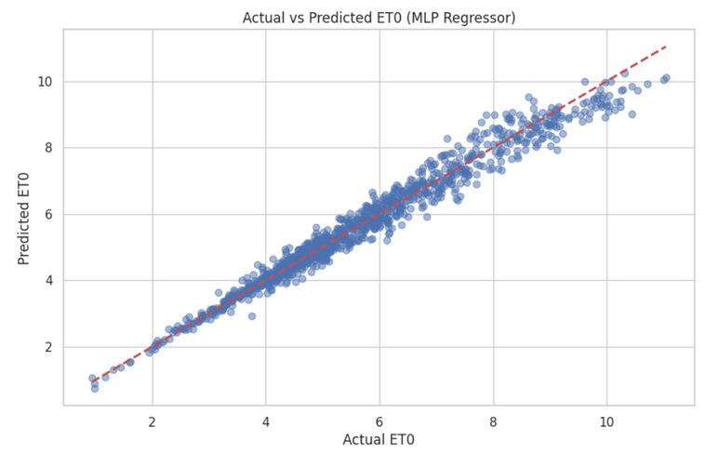
RESULTS
MLP regressor demonstrates superior predictive accuracy and generalization for ET₀ estimation, making it the preferred model for Edge‑AI–based irrigation forecasting.
CP 330: EDGE AI

Slide 11
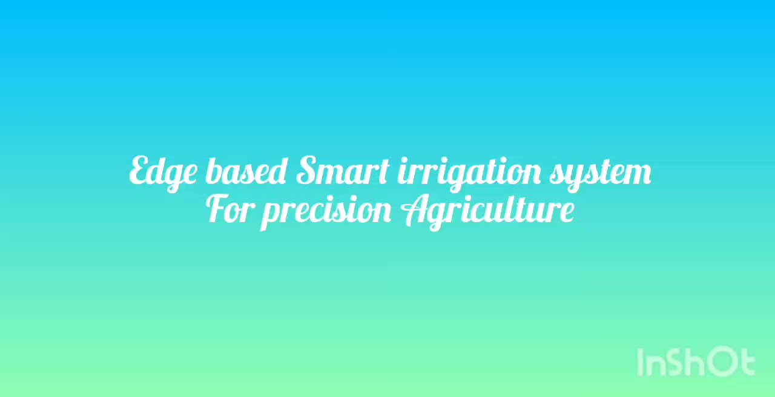

Slide 12
CHALLENGES & MITIGATIONS
1.
CHALLENGE: INTEGRATING MULTIPLE SENSORS
Mitigation: Use high‑quality sensors and deploy
multiple ESP32 nodes—each handling a subset of
sensors then aggregate data via Wi‑Fi to
the Raspberry Pi.
CHALLENGE: SENSOR ACCURACY DRIFTS AFTER CALIBRATION
3.
Employ premium, temperature‑compensated sensors and schedule periodic, in‑situ recalibrations to maintain measurement precision.
2.
CHALLENGES IN INTEGRATION OF MULTIPLE SENSORS
Install separate probes at each required depth and transmit readings over the integrated Wi‑Fi network to the Raspberry Pi.
CP 330: EDGE AI

Slide 13
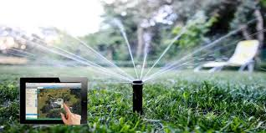

THANK
YOU!
CP 330: EDGE AI

